Slide 1


Enriching Social Situational Awareness in Remote Interactions - Insights and Inspirations from Disability Focused Research
CUbiC
CENTER FOR COGNITIVE UBIQUITOUS COMPUTING
Sreekar Krishna, Vineeth Balasubramanian, Sethuraman (Panch) Panchanathan
ARIZONA STATE UNIVERSITY

Slide 2
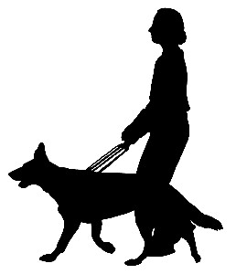



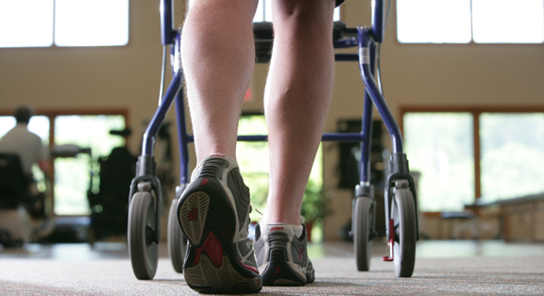
CUbiC
Recognition &
Learning
Healthcare Technologies
Assistive Technologies
Rehabilitative Technologies
HUMAN-CENTERED MULTIMEDIA COMPUTING
Technologies for Daily Living
Assistive Tech.
Sensing & Processing
Interaction & Delivery
Medical Decision Support
Rehabilitation Assessment & Training

Slide 3
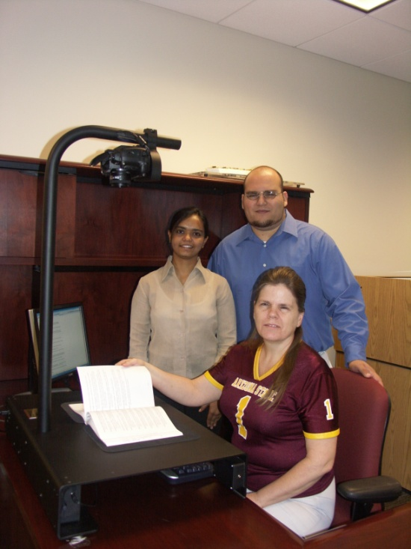
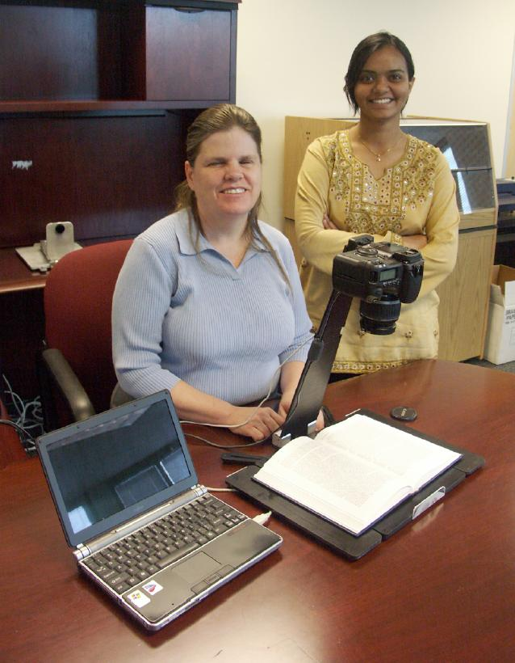
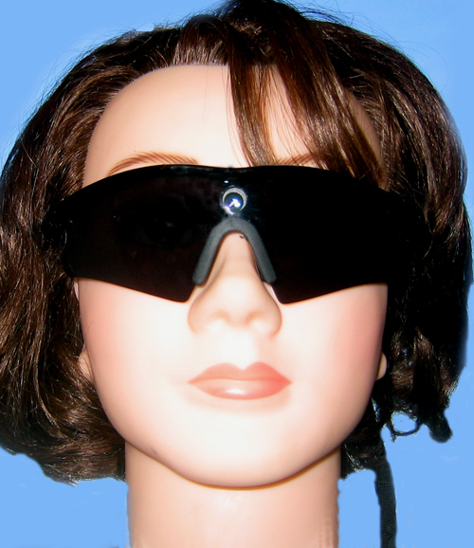

CUbiC Success Stories - iCARE Reader
Camera
Phase 1
2005
3 prototypes developed
Deployed in ASU and AzSDB
Phase 2
2006
Personal size
Customization capabilities
Phase 3
In development
Incorporating high resolution digital cameras on the glasses
CENTER FOR COGNITIVE UBIQUITOUS COMPUTING

Slide 4
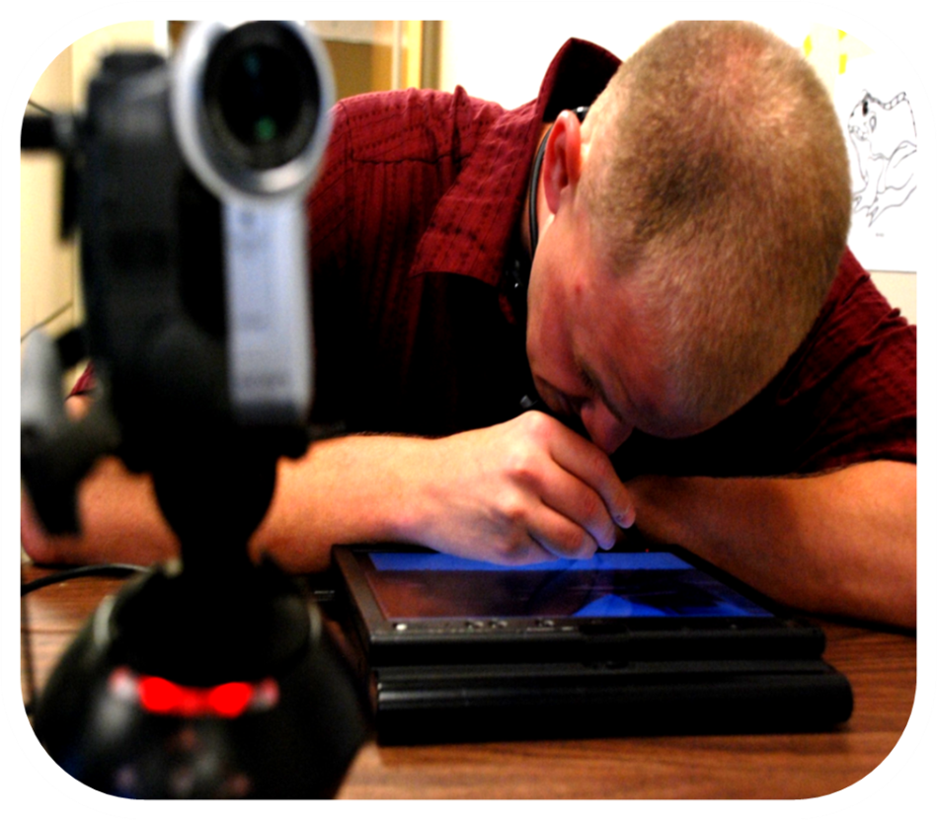
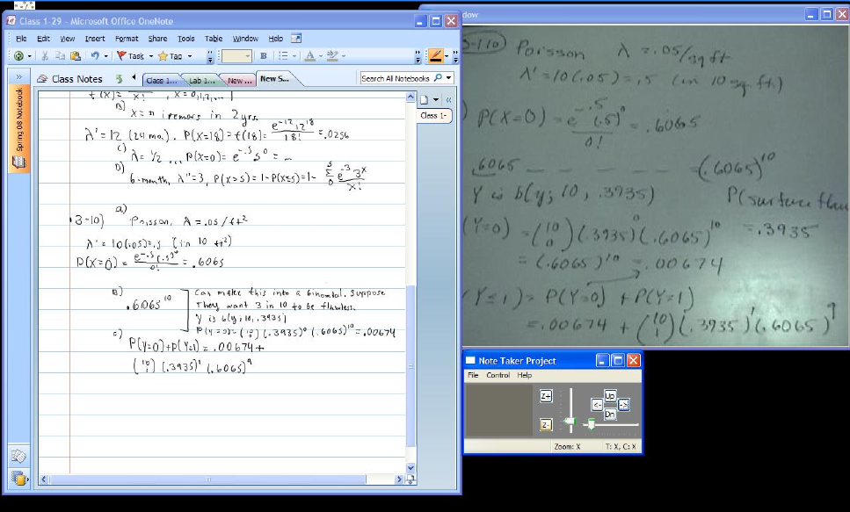
CUbiC Success Stories - NoteTaker
The assistive technology for low vision and legally blind students for taking notes in the classroom
Student notes with digital ink
Multi Touch Camera Control
Zoomed video of the lecturer’s presentation in real time
Winner of 2010 MS Imagine Cup Award
CENTER FOR COGNITIVE UBIQUITOUS COMPUTING

Slide 5
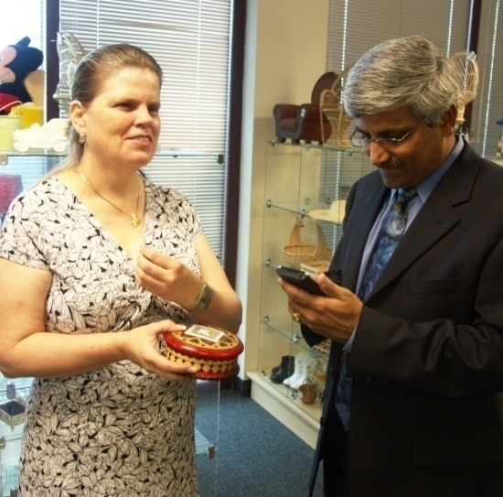
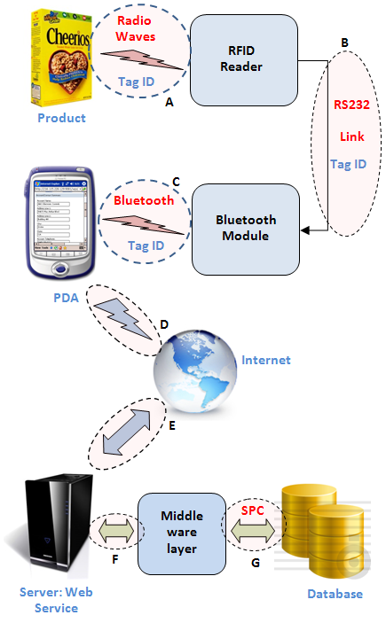
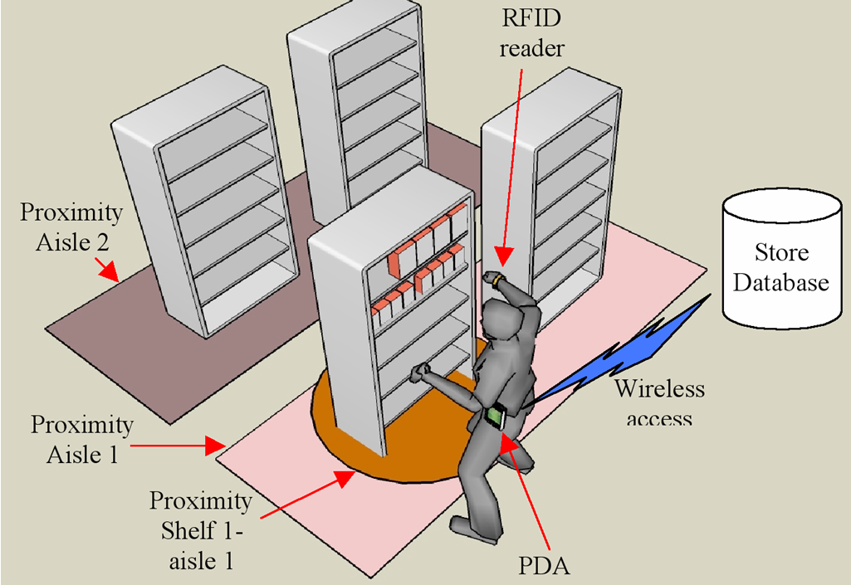
Shopping Assistance

Slide 6
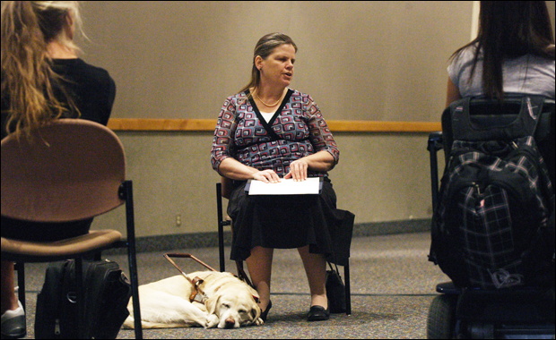
Social Assistance - Origin of the Problem
Dr. Terri Hedgpeth – Director, Disability Resource Center, ASU
Focus Group Study of Individuals who are Blind:
“It would be nice to walk into a room and immediately get to know who are all in front of me before they start a conversation”.
“It would be great to walk into a bar and identify a friend”.

Slide 7
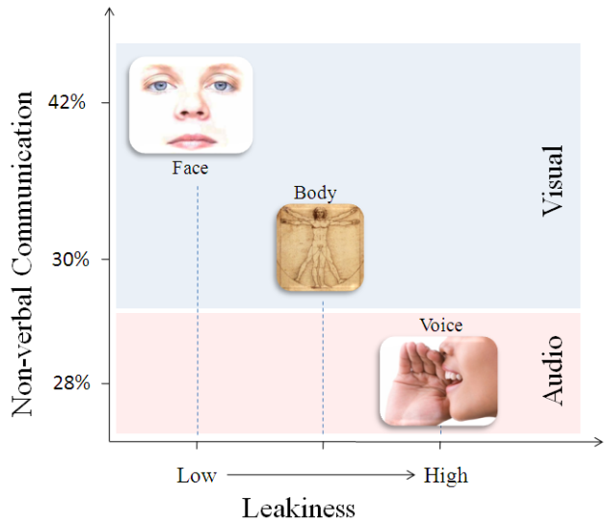
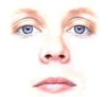
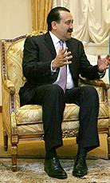
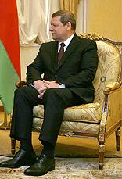
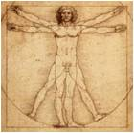

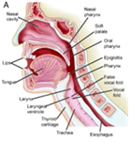
Interpersonal Social Interactions
Enactor (Encoding)
Recipient (Decoding)
Face
27%
Visual
Body
Non-verbal
65%
19%
Voice
18%
What role does touch play?
Audio
Speech
35%
35%
Verbal
Social Touch
N. Ambady and R. Rosenthal, “Thin slices of expressive behavior as predictors of interpersonal consequences: A meta-analysis.,” Psychological Bulletin. Vol. 111(2), vol. 111, Mar. 1992, pp. 256-274.

Slide 8



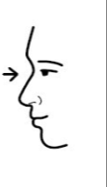
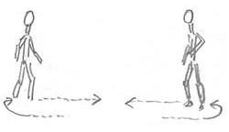
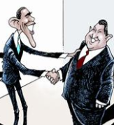

Socio-Behavior Example – Hand Shake
Handshake
Step 1: Eye Contact
Step 2: Intent to interact
Step 3: Move (Proxemics)
Sensory
Cognitive
Social Interactions
Perceptual
Motor
Step 4: Shake hands
Step 5: Conversation distance

Slide 9
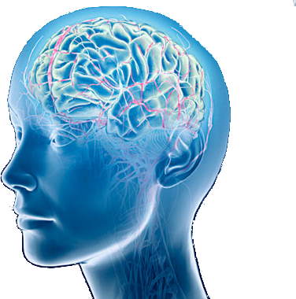
Social Interactions
Social Situational Awareness
Face
Body
Social Hearing
Social Cognition
Social Reciprocation
Voice
Social Sight
Social Touch
Social Stimulation
Social Stimulation
Social Cognition
Social Reciprocation

Slide 10
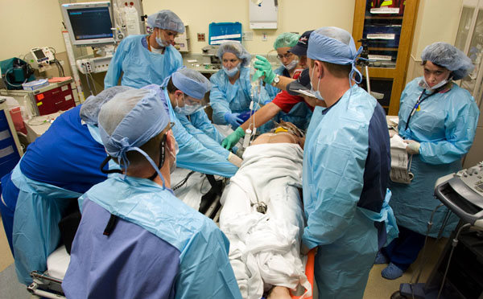
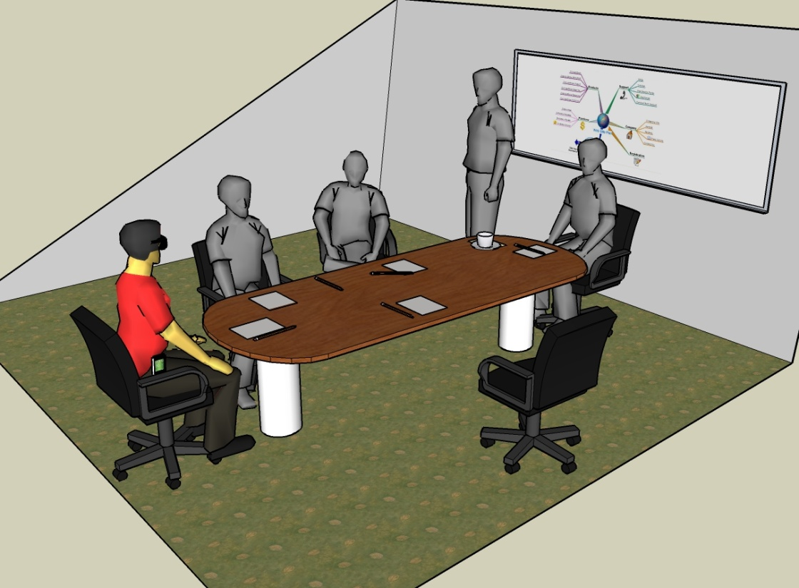
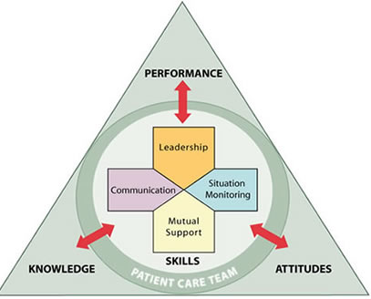
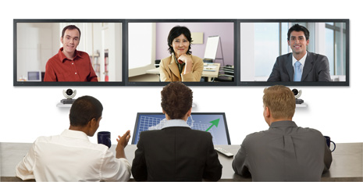
SSA in Various Settings
Social Assistance
Decision Making
Remote Collaborations
TeamSTEPPS
How many people?
Where are they located?
What are their facial expressions?
Eye Gaze
Eye Contact
Body Mannerisms
Expressing Opinion
Managing Conflict
Making Decision
Speed of Decision
Interaction with Colleagues
Difficulty Establishing Rapport
Leadership
Mutual Support
Communication
Attitude
Situation Monitoring
Patient Safety

Slide 11
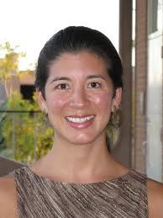
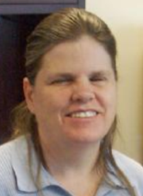



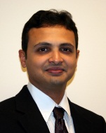


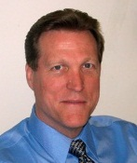
CUbiC Multidisciplinary Team
Technology, Psychology & Human Comm.
Tech. Dissemination & Validation
Assistive Technology
Team
Behavioral Psychology and Communication Team
Dr. Sethuraman Panchanathan
Comp. Sci. ASU
Human Centered Multimedia
Dr. Michele Shiota
Psychology, ASU
Interpersonal Interactions, Facial Expression, Dyadic Communications
Dr. Terri Hedgpeth
Dir. Disability Resource Center, ASU
Asst. Tech. Usability Expert, Early Adoption Specialist
Sreekar Krishna
Elec. Engg.
ASU
Integration Engg.
Dr. Don Homa
Psychology, ASU
Visual Perception, Working Memory, Haptic Concepts
Dr. Prasad Boradkar
School of Design, ASU
Assistive Tech. Design, Interdisciplinary Design Initiatives
Dr. Vineeth Balasubramanian
Comp. Sci. ASU
Decision Sys. & Risk Analysis
Dr. Artemio Ramirez
Human Comm., ASU
Remote Interactions and Communications, Modeling Professional Meetings, Conflict
Dr. Jameson Wetmore
Consortium of Science, Policy & Tech., ASU
Asst. Tech. Ethics, Practices & Effective Dissemination
Dr. John Black Jr.
Comp. Sci. ASU
Assistive Tech. Specialist

Slide 12
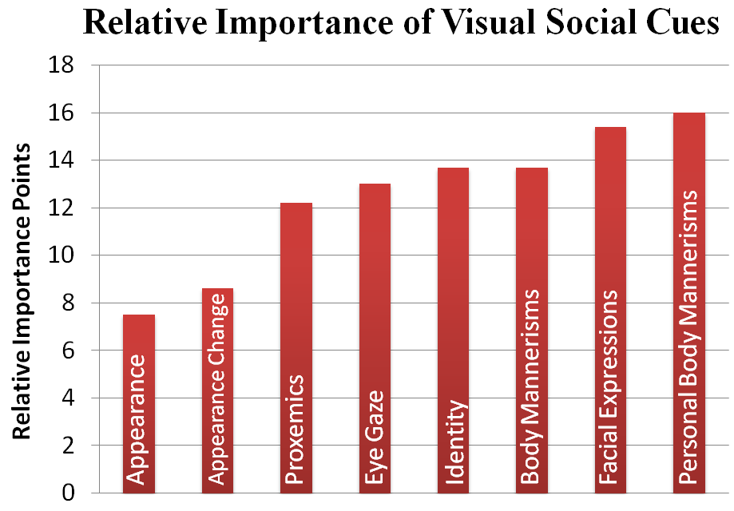
Social Interaction Assistant
Stereotypy
Social Scene Analysis
Face Reading

Slide 13
Stereotypy
Any non-functional repetitive behavior
Two main causes for stereotypy
Lack of sensory feedback
Lack of cognitive feedback
Methods of control Stereotypy
Intervention
Curtail Behavior immediately
Reward / Punishment
Self Monitoring
Do not intervene directly
Develop cognitive replacement
Body Rocking is the most prevalent stereotypy for people who are blind and visually impaired

Slide 14
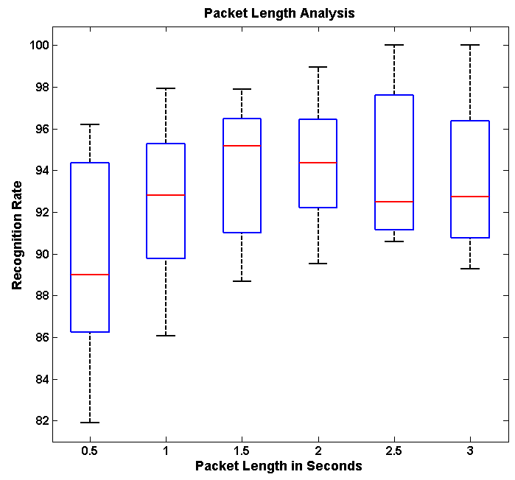
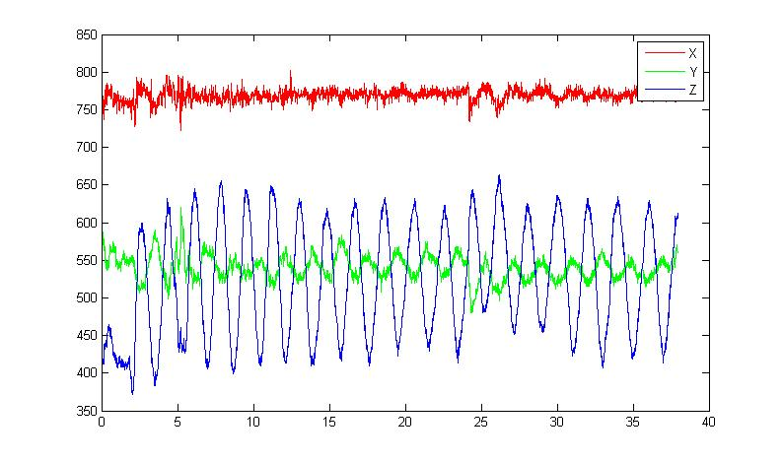
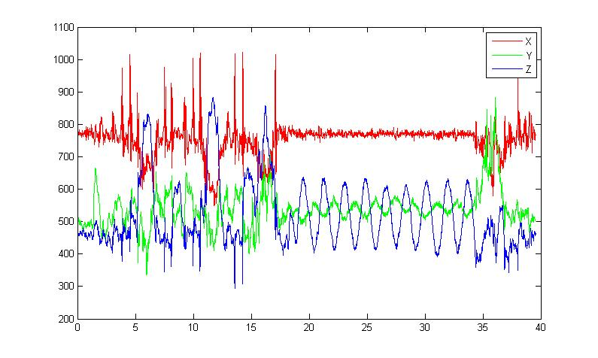
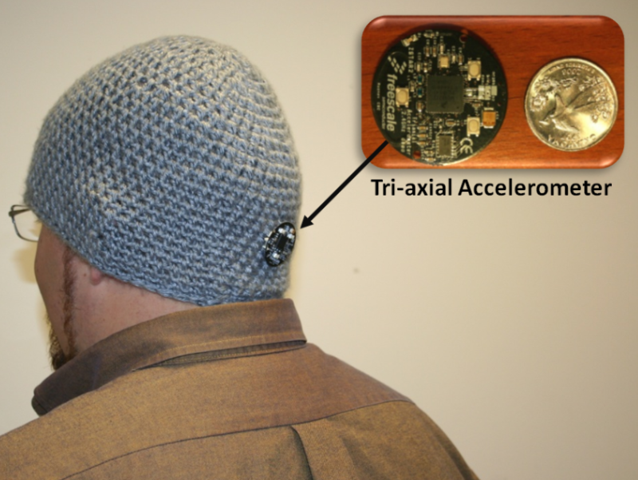
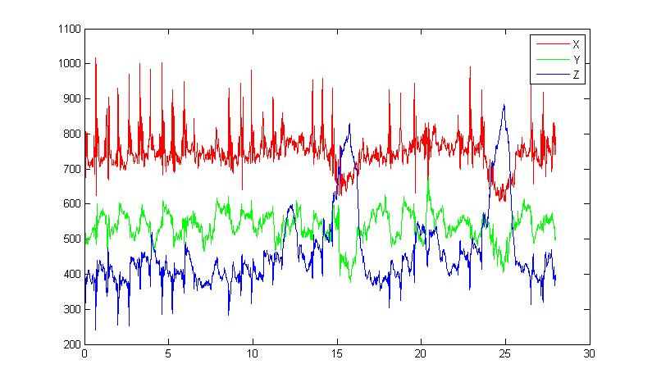
Proposed solution
Rocking
Z
Non - Rocking
Y
Rocking action can be recognized with an accuracy of 94% within 2 seconds
X
Behavioral Psychology literature shows that one rock action is approximately 2.2 seconds long. Effectively, recognizing a rocking behavior well within one rock cycle.

Slide 15
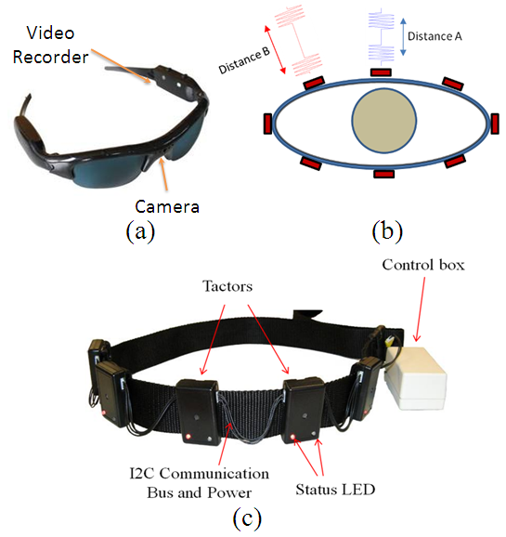
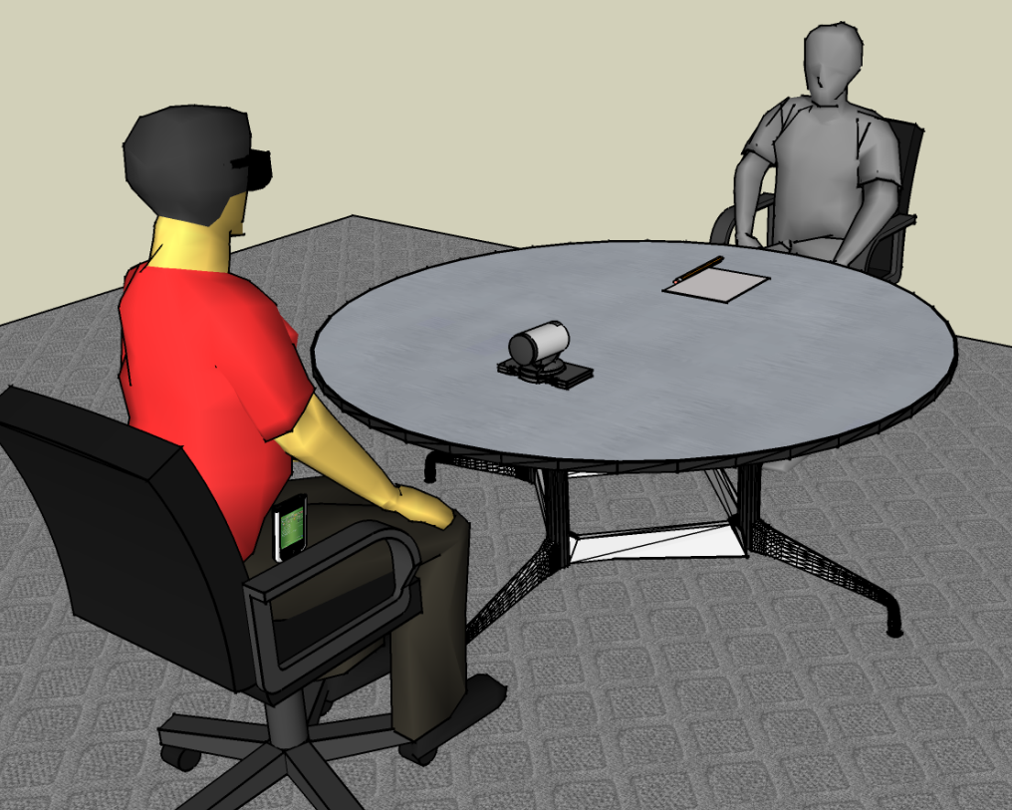
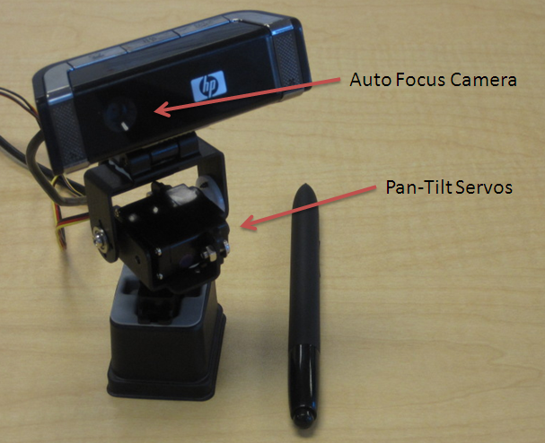
Dyadic Interaction – Face Reading
Camera
Social Interaction Asst.

Slide 16
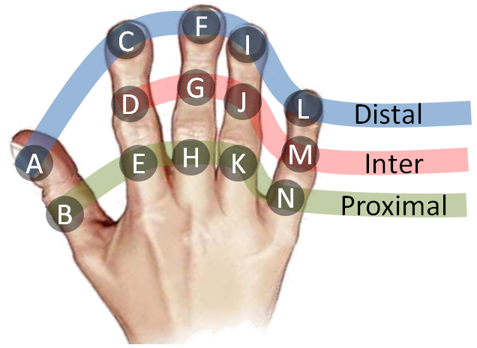
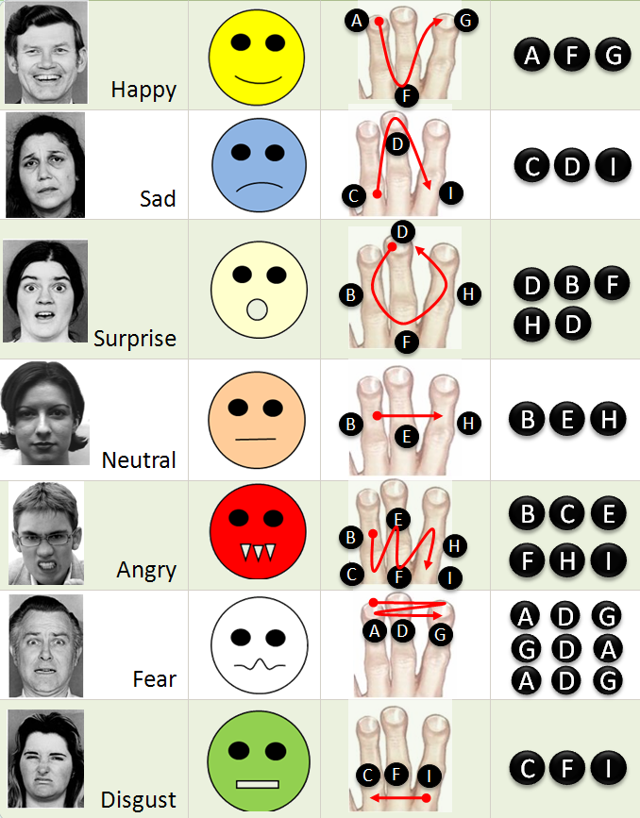
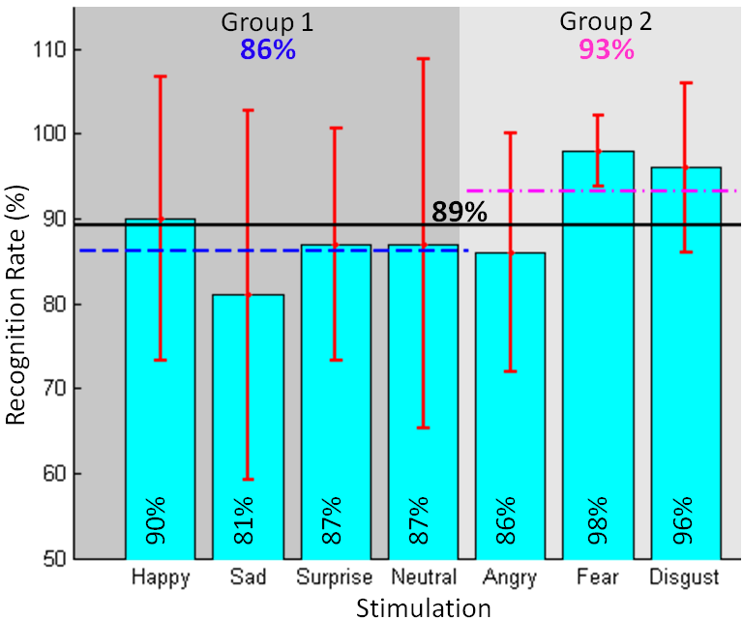
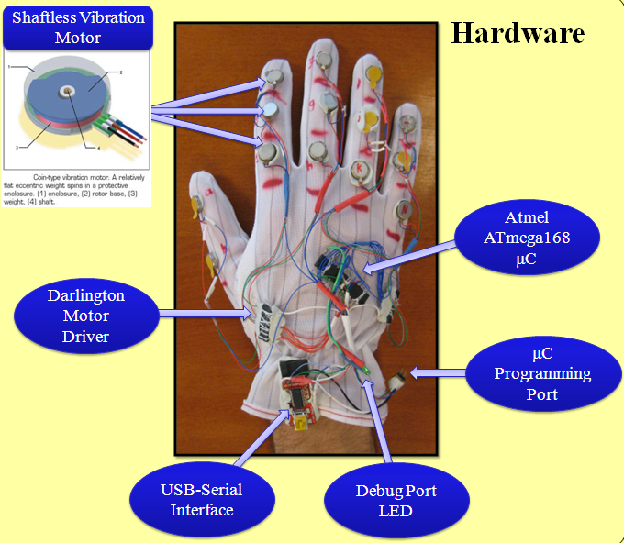
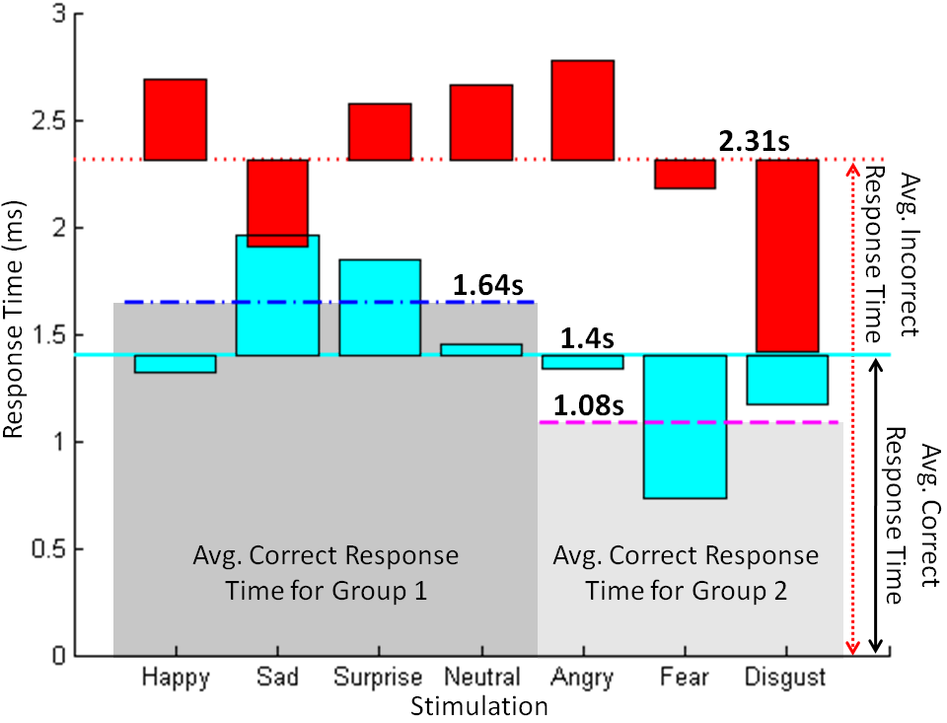
Dynamic Delivery of Facial Mannerisms

Slide 17
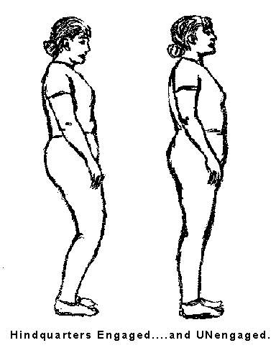
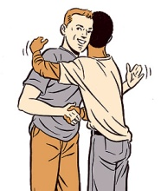
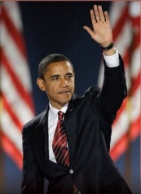
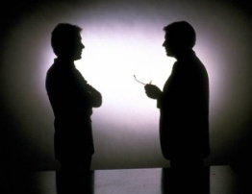

Social Gaze & Interaction Space
Interpersonal Space
0’
1.5’
4’
12’
25’
Intimate
Social
Personal
Public

Slide 18
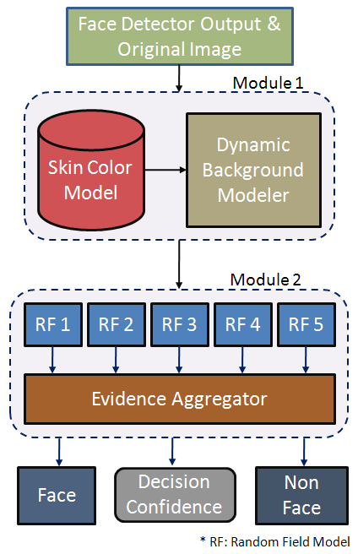
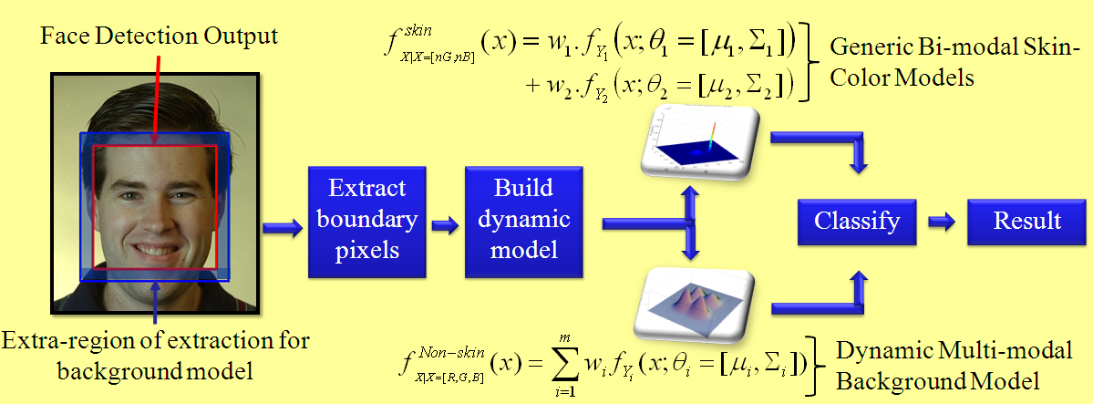
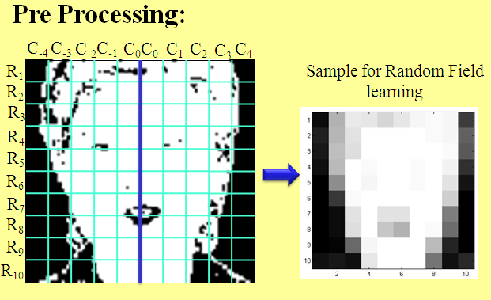


Modeling Distance & Direction through Face Detection
Module 1: Color Analysis
Module 3: Evidence Aggregation
Module 2: Markov Random Field LPCD

Slide 19



Structured Mode Searching Particle Filter (SMSPF)
Step 1
Step 2
Motivation: Weak Temporal Redundancy
Motivation:ComplexObject Structure & Abrupt Motion
Approach: Deterministic Search over a small probable search space (Histogram of Gradients with Chamfer Match)
Approach: Stochastic Search over
a large search space (Color Histogram Comparison)
Result: Approximate Estimate
Initial Estimate
Corrected Estimate
Example Search Windows
Result: Accurate Estimate

Slide 20



Face/Person Detection/Tracking
Face Detection
Person Detection
Tracking
Model
Deliver

Slide 21

Social Scene Delivery System

Slide 22



Conveying Body Mannerisms
Social Interaction Assistant
Enactor
Body Posture
Body Gestures
Social Mirror
Social Interaction Assistant
Recipient

Slide 23



Disability & Deficit Inspired Computing
Activities of Daily Living (ADL)
Did you know the typewriter was invented
for the blind?
Disabled Population
Design and Develop Assistive Tech.
Identify Barriers to ADL
Disseminate
Refine
Observe
Extrapolate to the general population
Blindness is only a concept

Slide 24
Mayo Multi-disciplinary Simulation Center
Doctors, Nurses, Professionals, etc.
On-body Affect Sensors
Environment Affect Sensors
Vision
Audio
Automated monitoring of group dynamics to determine communication breakdowns
Automatic evaluation of the social affinity between team members
Leadership evaluation and nomination through long term monitoring of teams and individuals

Slide 25
Assisting Remote Interactions
The Challenges of Working in Virtual Teams: Virtual Teams Survey Report 2010. RW3 CultureWizard, 2010.
Challenges in virtual teams compared to face-to-face teams
Top five challenges faced during virtual team meeting
Personal challenges during virtual team meetings
Sense of isolation
Colleague not participate
Reliance on email and telephone
Method of decision making
Expressing Opinion
Difficulty seeing the whole picture
Different leadership styles
Making Decision
Difficulty establishing rapport and trust
Speed of decision making
Absence of collegiality
Managing Conflict
Insufficient time to build relations
Inability to read non-verbal cues

Slide 26
Socio-Behavioral Computing
Design & Engineering
Affective Computing
Social Robotics
Human Communication Dynamics
Human Centered Computing
User Behavior Modeling
Sensor & Actuator Technologies
Human Computer Interaction
Social, Behavioral & Personal Dynamics
Questions?
SBC
Modeling & Simulation
Abstract Interaction
Machine Learning and Pattern Recognition
Socio Behavioral Computing

